Slide 1
Graphs

Slide 2
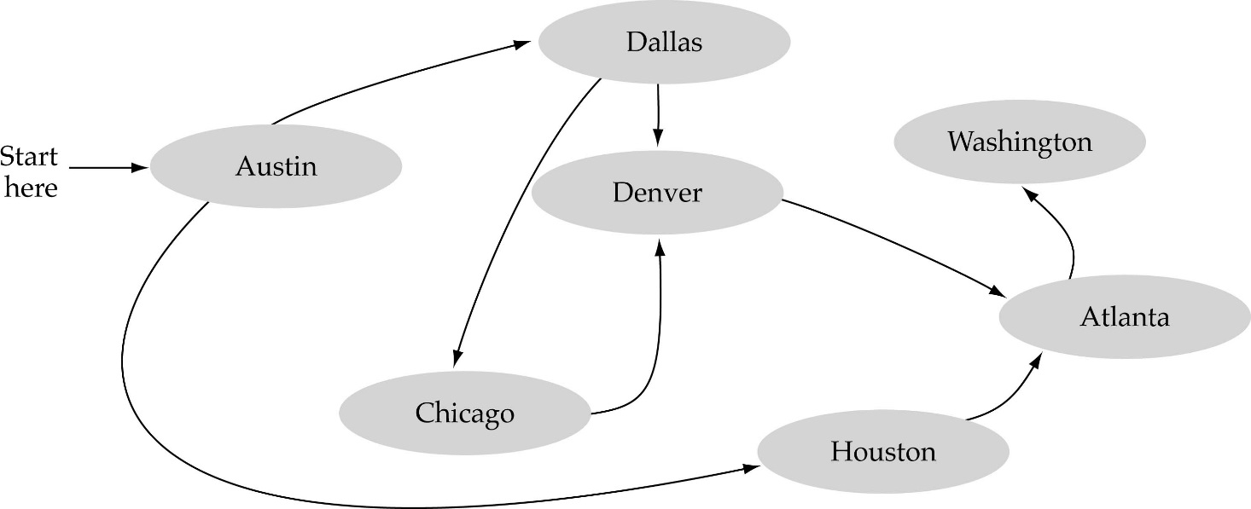
What is a graph?
A data structure that consists of a set of nodes (vertices) and a set of edges that relate the nodes to each other
The set of edges describes relationships among the vertices

Slide 3
Formal definition of graphs
A graph G is defined as follows:
G=(V,E)
V(G): a finite, nonempty set of vertices
E(G): a set of edges (pairs of vertices)

Slide 4
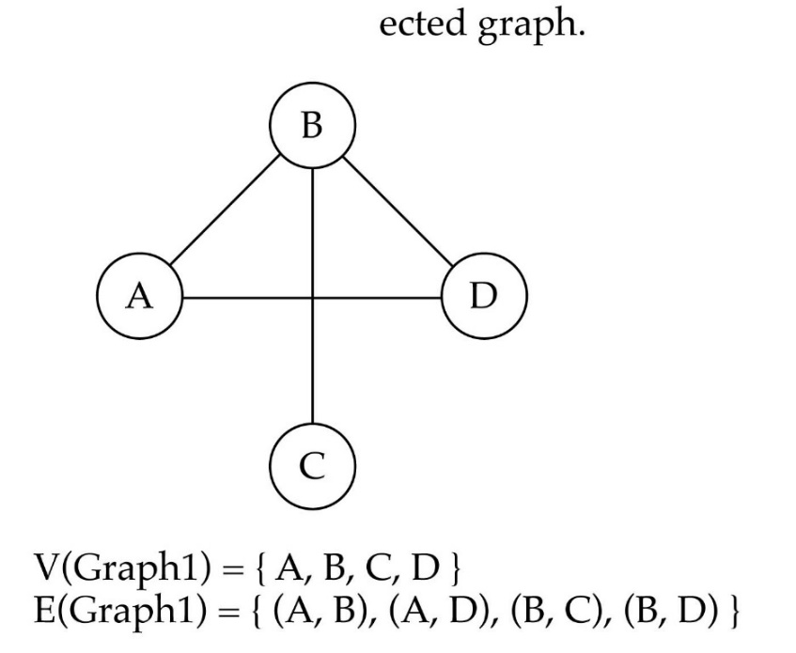
Directed vs. undirected graphs
When the edges in a graph have no direction, the graph is called undirected

Slide 5

Directed vs. undirected graphs (cont.)
When the edges in a graph have a direction, the graph is called directed (or digraph)
Warning: if the graph is directed, the order of the vertices in each edge is important !!
E(Graph2) = {(1,3) (3,1) (5,9) (9,11) (5,7)

Slide 6

Trees vs graphs
Trees are special cases of graphs!!

Slide 7

Graph terminology
Adjacent nodes: two nodes are adjacent if they are connected by an edge
Path: a sequence of vertices that connect two nodes in a graph
Complete graph: a graph in which every vertex is directly connected to every other vertex
5 is adjacent to 7
7 is adjacent from 5

Slide 8
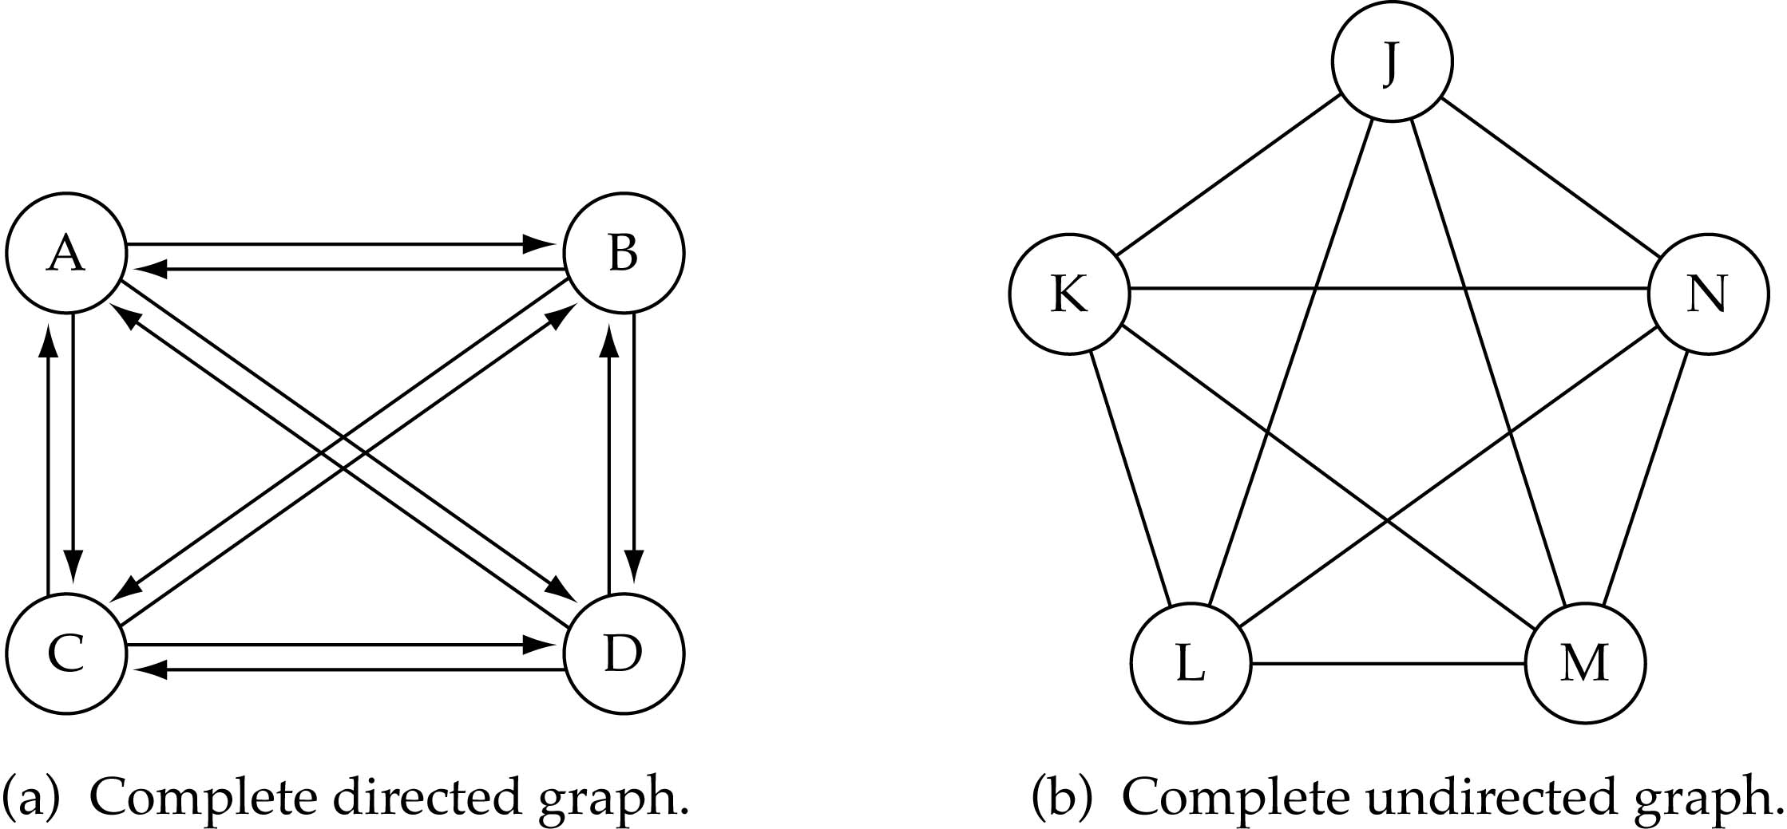
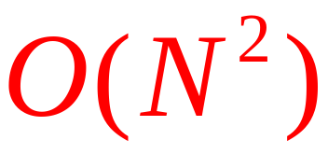
Graph terminology (cont.)
What is the number of edges in a complete directed graph with N vertices?
N * (N-1)

Slide 9
Graph terminology (cont.)
What is the number of edges in a complete undirected graph with N vertices?
N * (N-1) / 2

Slide 10
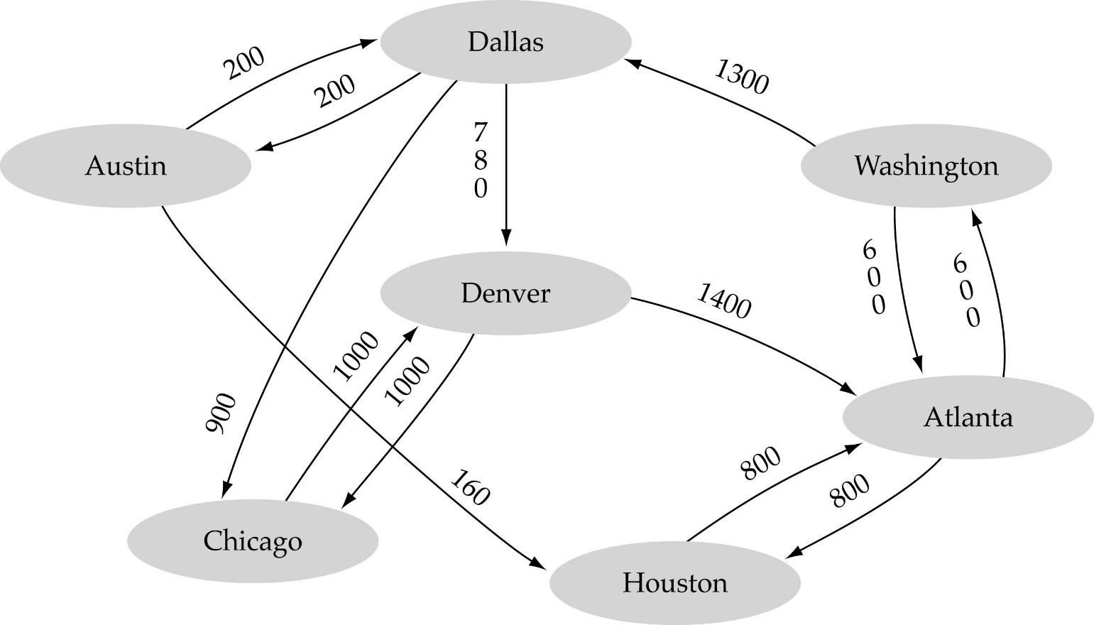
Graph terminology (cont.)
Weighted graph: a graph in which each edge carries a value

Slide 11
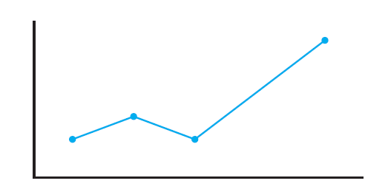
Graph terminology (cont.)
An ordinary line graph

Slide 12
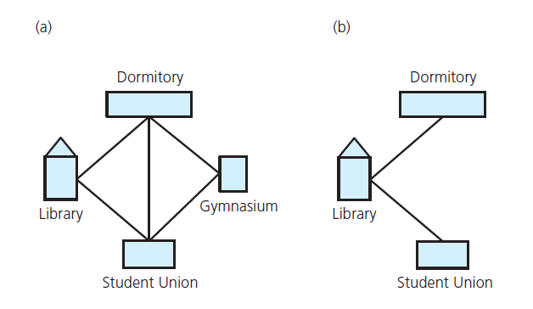
Graph terminology (cont.)
(a) A campus map as a graph;
(b) a subgraph

Slide 13
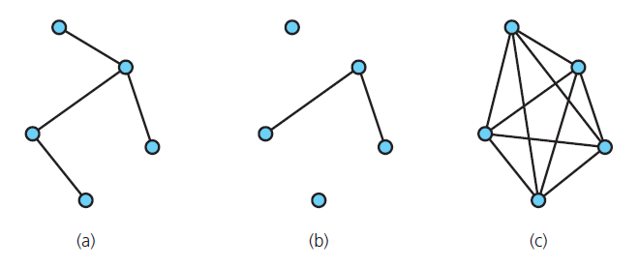
Graph terminology (cont.)
(a) connected;
(b) disconnected; and (c) complete

Slide 14
Graph terminology (cont.)
Simple path: passes through vertex only once (A → B → C → D)
Cycle: a path that begins and ends at same vertex (A → B → C → D → A)
Simple cycle: A simple cycle is a cycle that does not repeat any vertex except for the starting/ending vertex.
Connected graph: each pair of distinct vertices has a path between them

Slide 15
Graph terminology (cont.)
Complete graph: each pair of distinct vertices has an edge between them
Graph cannot have duplicate edges between vertices
  Multigraph: does allow multiple edges
When labels represent numeric values, graph is called a weighted graph

Slide 16
Graph terminology (cont.)
Undirected graphs: edges do not indicate a direction
Directed graph, or digraph: each edge has a direction

Slide 17
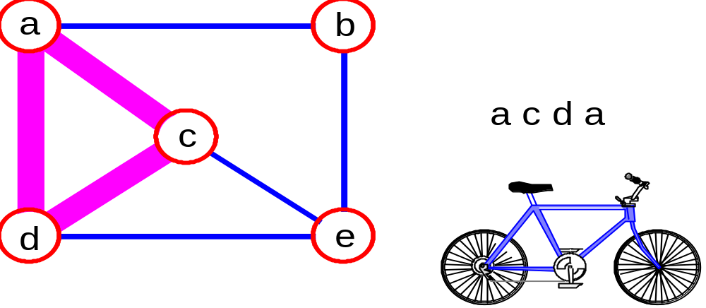
Graph terminology (cont.)
simple path: no repeated vertices
cycle: simple path, except that the last vertex is the same as the first vertex
a
b
b e c
c
d
e

Slide 18
Pseudographs
If self-loops are allowed we get a pseudograph:
Now edges may be associated with a single vertex, when the edge is a loop
e₁ → {1,2}, e₂ → {1,2}, e₃ → {1,3},
e₄ → {2,3}, e₅ → {2}, e₆ → {2}, e₇ → {4}
e₆
e₁
1
e₂
2
e₃
e₅
e₄
e₇
3
4
L23

Slide 19
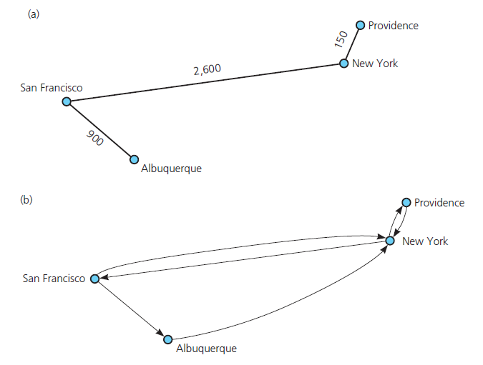
Graph terminology (cont.)
(a) A weighted graph
(b) a directed graph

Slide 20

Graph implementation
Array-based implementation
  A 1D array is used to represent the vertices
  A 2D array (adjacency matrix) is used to represent the edges

Slide 21
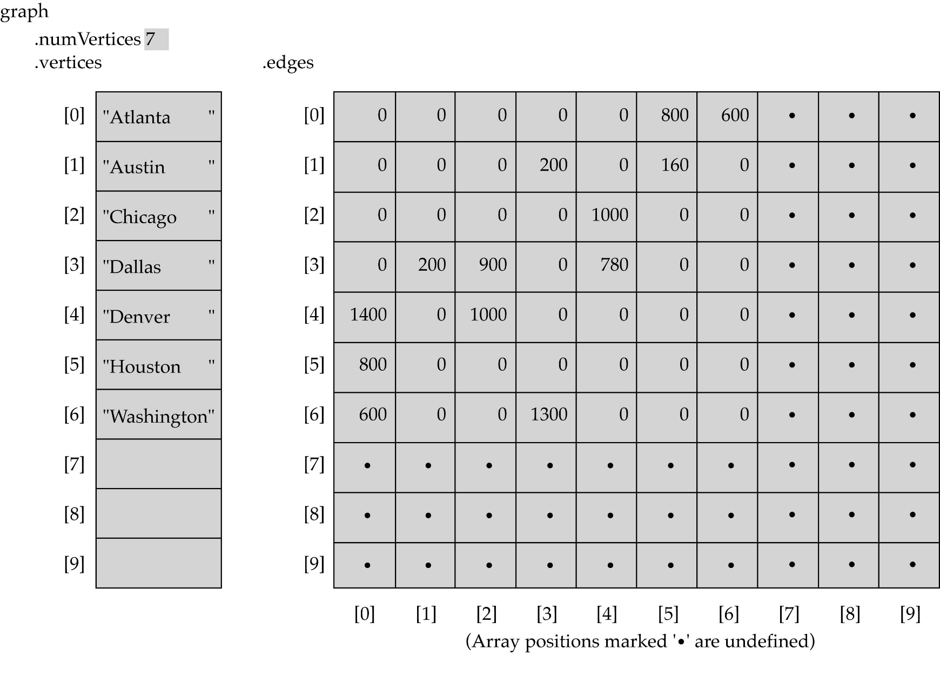
Array-based implementation

Slide 22

Graph implementation (cont.)
Linked-list implementation
  A 1D array is used to represent the vertices
  A list is used for each vertex v which contains the vertices which are adjacent from v (adjacency list)

Slide 23
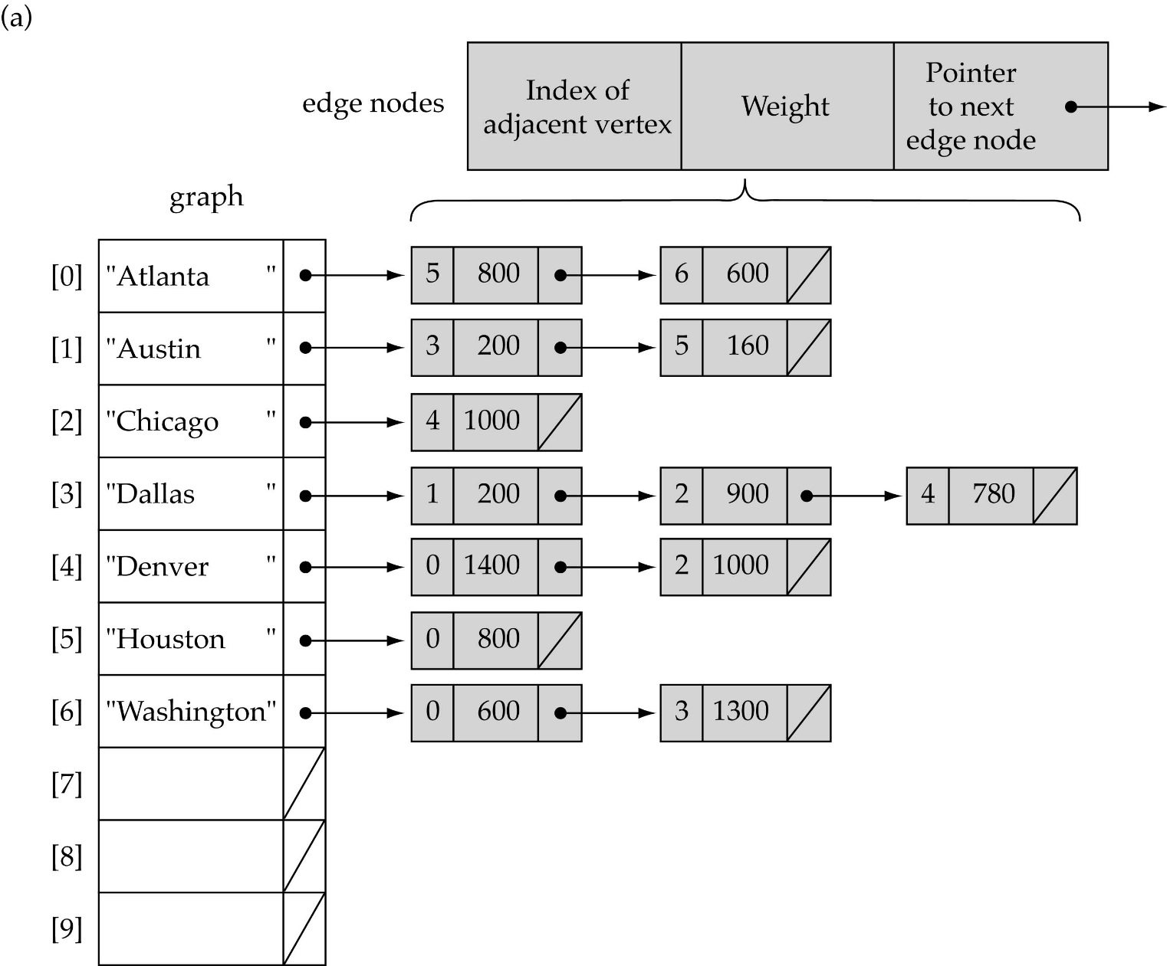
Linked-list implementation

Slide 24
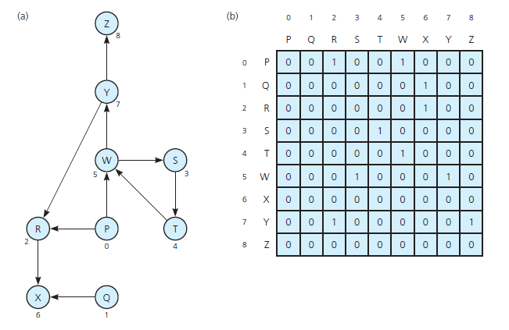
Implementing Graphs
(a) A directed graph and
(b) its adjacency matrix

Slide 25
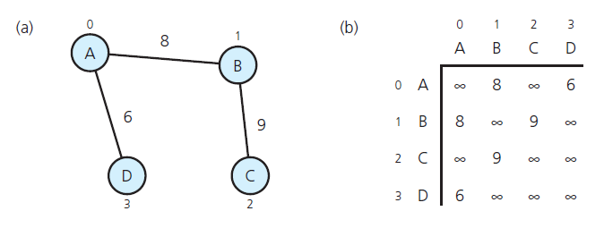
Implementing Graphs
(a) A weighted undirected graph and
(b) its adjacency matrix

Slide 26
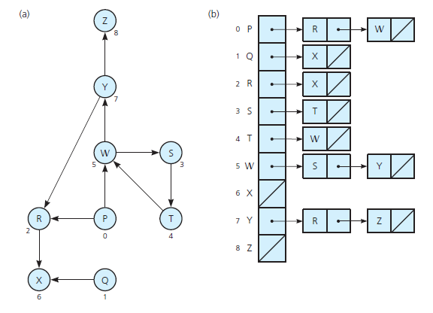
Implementing Graphs
(a) A directed graph and
(b) its adjacency list

Slide 27
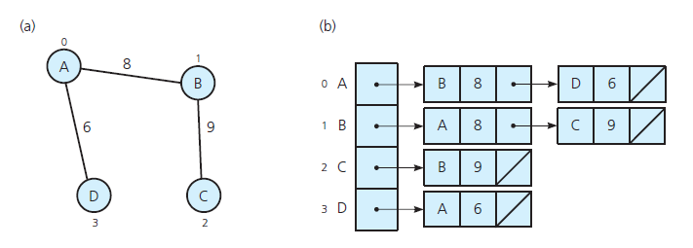
Implementing Graphs
(a) A weighted undirected graph and
(b) its adjacency list

Slide 28
Adjacency matrix vs. adjacency list representation
Adjacency matrix
  Good for dense graphs
  Memory requirements:
  Connectivity between two vertices can be tested quickly
Adjacency list
  Good for sparse graphs
  Memory requirements:
  Vertices adjacent to another vertex can be found quickly

Slide 29
Graph Searching/Traversals
Visits all of the vertices that it can reach
  Happens if and only if graph is connected
Connected component is subset of vertices visited during traversal that begins at given vertex

Slide 30
Graph searching
Problem: find a path between two nodes of the graph (e.g., Austin and Washington)
Methods: Depth-First-Search (DFS) or Breadth-First-Search (BFS)

Slide 31
Depth-First-Search (DFS)
What is the idea behind DFS?
  Travel as far as you can down a path
  Back up as little as possible when you reach a "dead end" (i.e., next vertex has been "marked" or there is no next vertex)
DFS can be implemented efficiently using a stack

Slide 32
Depth-First-Search (DFS) (cont.)
Set found to false
stack.Push(startVertex)
DO
stack.Pop(vertex)
IF vertex == endVertex
Set found to true
ELSE
Push all adjacent vertices onto stack
WHILE !stack.IsEmpty() AND !found
IF(!found)
Write "Path does not exist"

Slide 33
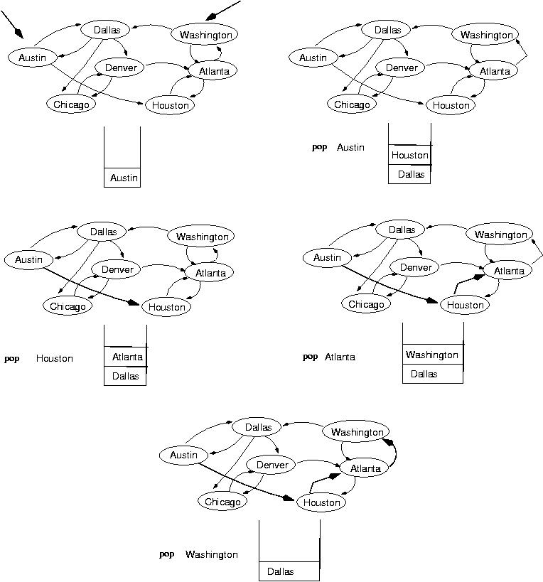
start
end
(initialization)

Slide 36
Breadth-First-Searching (BFS)
What is the idea behind BFS?
  Look at all possible paths at the same depth before you go at a deeper level
  Back up as far as possible when you reach a "dead end" (i.e., next vertex has been "marked" or there is no next vertex)

Slide 37
Breadth-First-Searching (BFS) (cont.)
BFS can be implemented efficiently using a queue
  Set found to false
  queue.Enqueue(startVertex)
  DO
  queue.Dequeue(vertex)
  IF vertex == endVertex
  Set found to true
  ELSE
  Enqueue all adjacent vertices onto queue
  WHILE !queue.IsEmpty() AND !found
Should we mark a vertex when it is enqueued or when it is dequeued ?
IF(!found)
Write "Path does not exist"

Slide 38
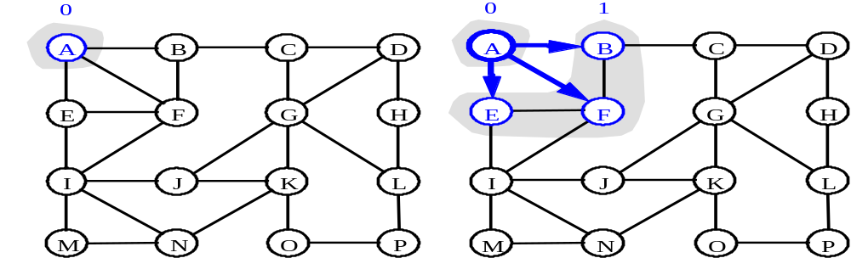
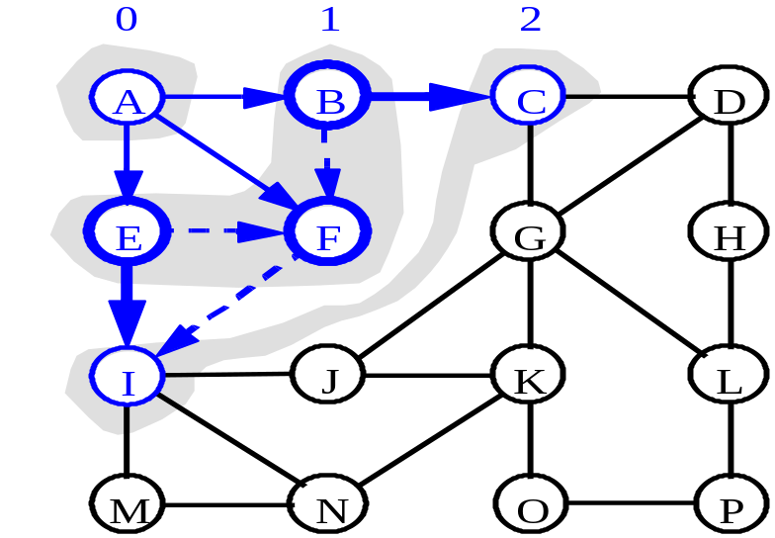
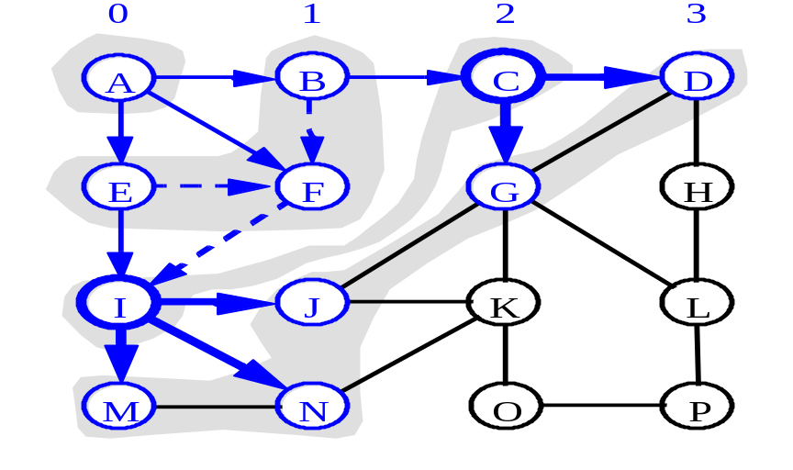
BFS - A Graphical Representation
b)
a)
c)
d)

Slide 39
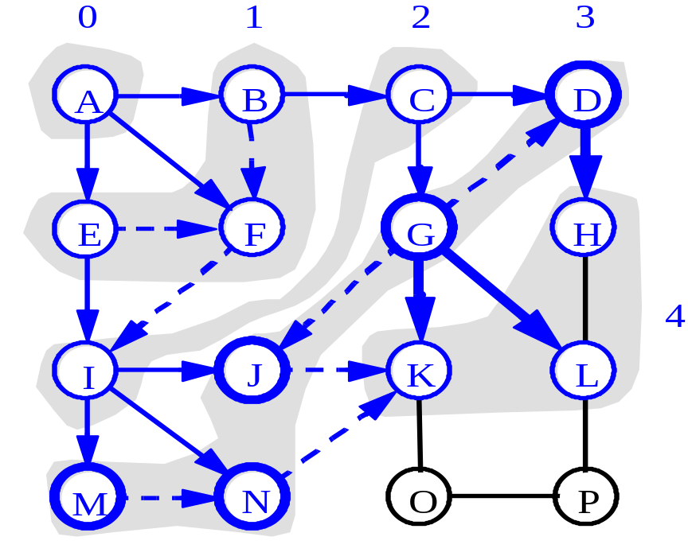
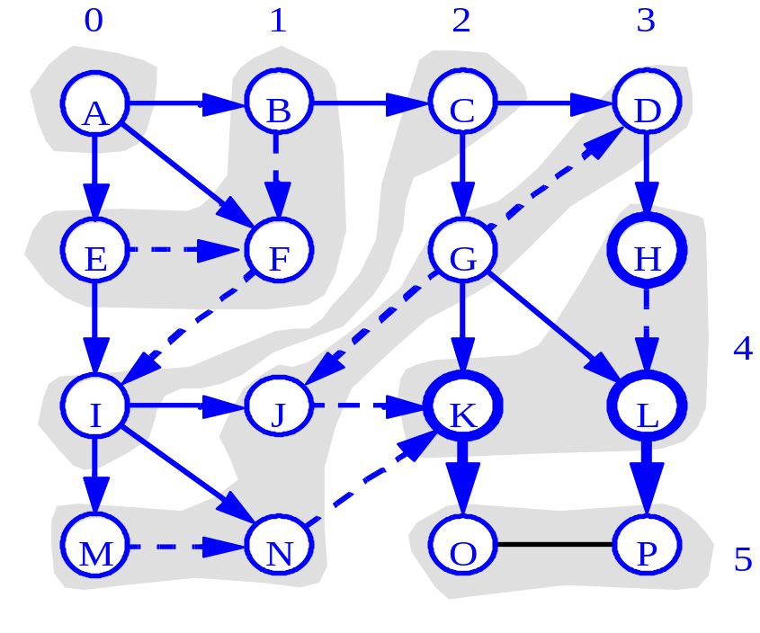
More BFS

Slide 40
Single-source shortest-path problem
There are multiple paths from a source vertex to a destination vertex
Shortest path: the path whose total weight (i.e., sum of edge weights) is minimum
Examples:
  Austin->Houston->Atlanta->Washington: 1560 miles
  Austin->Dallas->Denver->Atlanta->Washington: 2980 miles

Slide 41
Single-source shortest-path problem (cont.)
Common algorithms: Dijkstra's algorithm, Bellman-Ford algorithm
BFS can be used to solve the shortest graph problem when the graph is weightless or all the weights are the same
        (mark vertices before Enqueue)

Slide 42
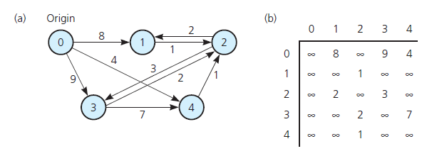
Shortest Paths
Shortest path between two vertices in a weighted graph has smallest edge-weight sum
(a) A weighted directed graph
and (b) its adjacency matrix

Slide 43
Shortest Paths
Dijkstra’s shortest-path algorithm
Assign to every node a tentative distance value: set it to zero for our initial node and to infinity for all other nodes.
Mark all nodes unvisited. Set the initial node as current. Create a set of the unvisited nodes called the unvisited set consisting of all the nodes.
For the current node, consider all of its unvisited neighbors and calculate their tentative distances. Compare the newly calculated tentative distance to the current assigned value and assign the smaller one. For example, if the current node A is marked with a distance of 6, and the edge connecting it with a neighbor B has length 2, then the distance to B (through A) will be 6 + 2 = 8. If B was previously marked with a distance greater than 8 then change it to 8. Otherwise, keep the current value.

Slide 44
Shortest Paths
When we are done considering all of the neighbors of the current node, mark the current node as visited and remove it from the unvisited set. A visited node will never be checked again.
If the destination node has been marked visited (when planning a route between two specific nodes) or if the smallest tentative distance among the nodes in the unvisited set is infinity (when planning a complete traversal; occurs when there is no connection between the initial node and remaining unvisited nodes), then stop. The algorithm has finished.
Select the unvisited node that is marked with the smallest tentative distance, and set it as the new "current node" then go back to step 3.

Slide 45
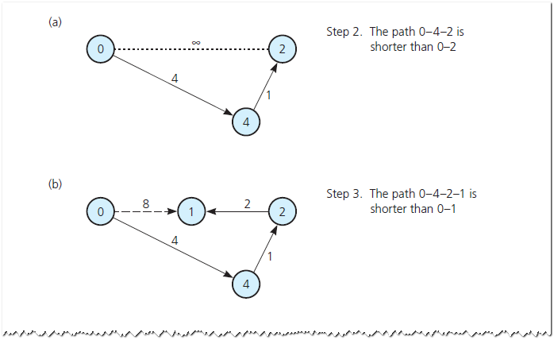
Shortest Paths
Checking weight [u] by examining the graph: (a) weight [2] in step 2; (b) weight [1] in step 3;

Slide 46
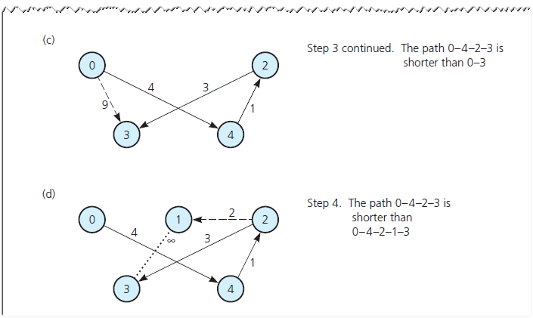
Shortest Paths
Checking weight [u] by examining the graph(c) weight [3] in step 3; (d) weight [3] in step 4

